Slide 1

Wood Carving
Merit Badge
Troop 344/9344
Pemberville, OH

Slide 2
Requirements
Do the following:
  Explain to your counselor the hazards you are most likely to encounter while wood carving, and what you should do to anticipate, help prevent, mitigate, or lessen these hazards.
  Show that you know first aid for injuries that could occur while wood carving, including minor cuts and scratches and splinters.
Do the following:
  Earn the Totin' Chip recognition.
  Discuss with your merit badge counselor your understanding of the Safety Checklist for Carving.

Slide 3
Requirements
Do the following:
  Explain to your counselor, orally or in writing, the care and use of five types of tools that you may use in a carving project.
  Tell your counselor how to care for and use several types of sharpening devices, then demonstrate that you know how to use these devices.
Using a piece of scrap wood or a project on which you are working, show your merit badge counselor that you know how to do the following:
  Paring cut
  Push cut and levering cut
  "V" cut
  Stop cut or score line

Slide 4
Requirements
Tell why different woods are used for different projects. Explain why you chose the type of wood you did for your projects in requirements 6 and 7.
Plan your own or select a project from this (the Wood Carving) merit badge pamphlet and complete a simple carving in the round.
Complete a simple low-relief OR a chip carving project.

Slide 5
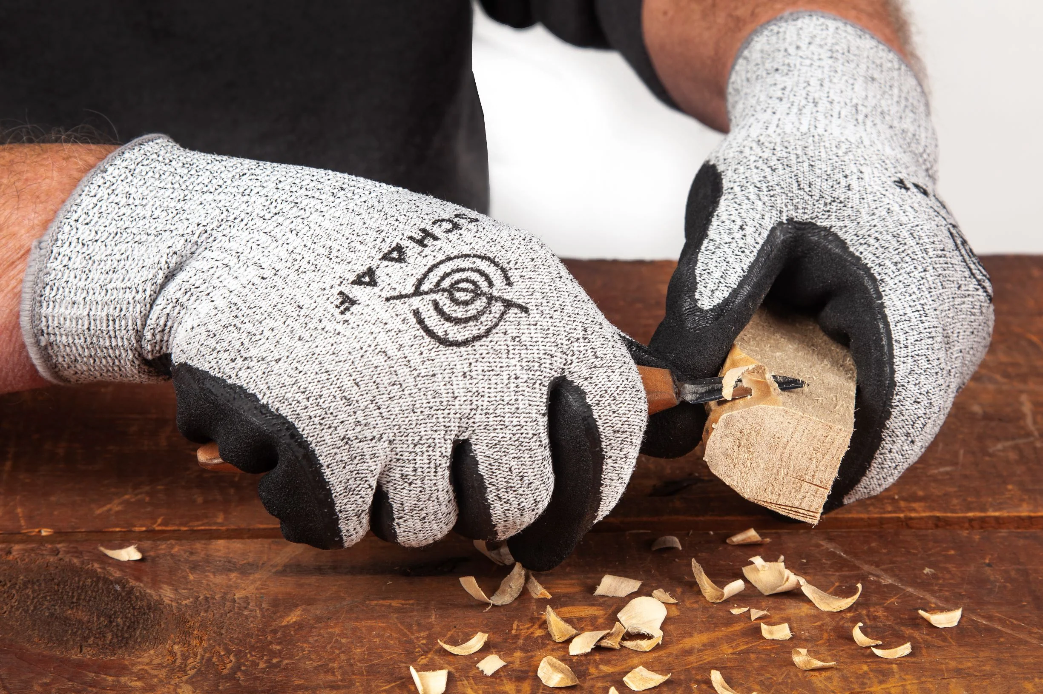
Requirement 1
Do the following:
  Explain to your counselor the hazards you are most likely to encounter while wood carving, and what you should do to anticipate, help prevent, mitigate, or lessen these hazards.
  Show that you know first aid for injuries that could occur while wood carving, including minor cuts and scratches and splinters.

Slide 6
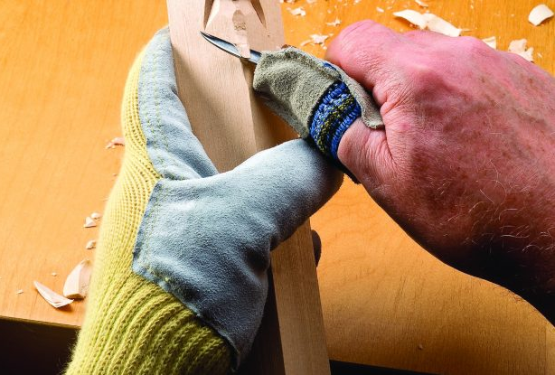
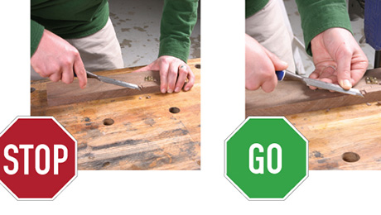
Hazards of Wood Carving
While conducting wood carving activities you may be working with sharp objects and it is important to use safety measures to protect yourself from any physical harm.
Always:
Wear safety glasses when using utility knives. Blades can snap off unexpectedly.
Wear cut/puncture resistant gloves when using knives/pointed items to avoid getting cut or a puncture wound.
Use sharp blades. Dull blades require more force to make the cut, which can lead to tool slippage.
Always cut away from the body and face, making several passes when cutting thicker materials.
Stay focused. Distraction can be dangerous!
Make sure blades are fitted properly into the knife.
Make sure to cap the sharp object and when finished, place it into a solid container.

Slide 7
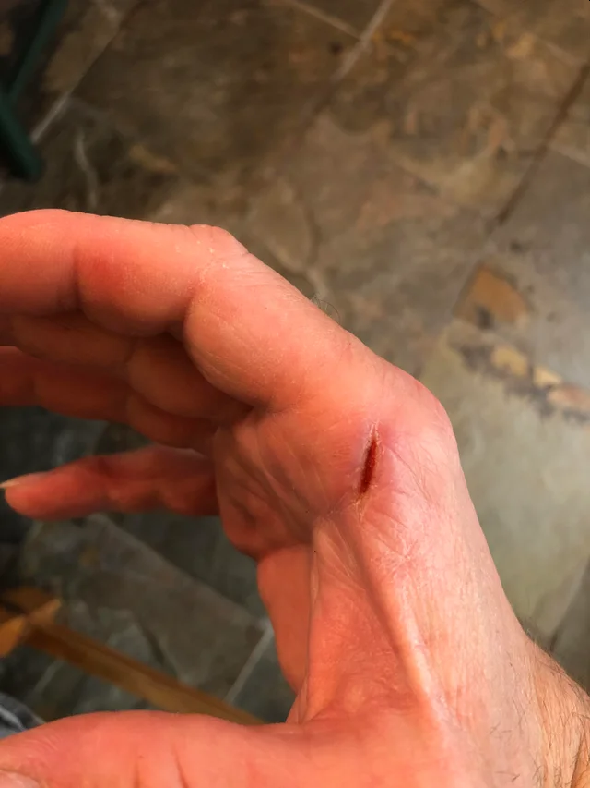
Hazards of Wood Carving
While conducting wood carving activities you may be working with sharp objects and it is important to use safety measures to protect yourself from any physical harm.
Never:
Never leave a blade unattended, especially with the blade exposed.
Never cut items with a blade or other sharp object on your lap.
Never carry a cutting utensil by the blade to avoid cutting your fingers.
Never use a blade without a holder.
Never pass a blade to another person by tossing it; hand it over carefully by the handle and with the blade down or if possible, retracted.
Never try to catch a blade or cutting tool that is falling.

Slide 8
First Aid for Wood Carving Injuries
Minor cuts scratches, and scrapes usually don't require a trip to the emergency room. These guidelines can help you care for such wounds:
Wash your hands: This helps avoid infection. Also put on disposable protective gloves if they're available.
Stop the bleeding: Minor cuts and scrapes usually stop bleeding on their own. If not, apply gentle pressure with a sterile bandage or clean cloth and elevate the wound.
Clean the wound: Use clear water to rinse the wound. Also clean around the wound with soap and warm water.
Apply an antibiotic: Apply a thin layer of an antibiotic cream or ointment (Neosporin).
Cover the wound: Bandages can help keep the wound clean and keep harmful bacteria out.
Get stitches for deep wounds: A deep — all the way through the skin — gaping or jagged wound will need stitches
Watch for signs of infection: See your doctor if the wound isn't healing or you notice any redness, increasing pain, drainage, warmth or swelling.

Slide 9
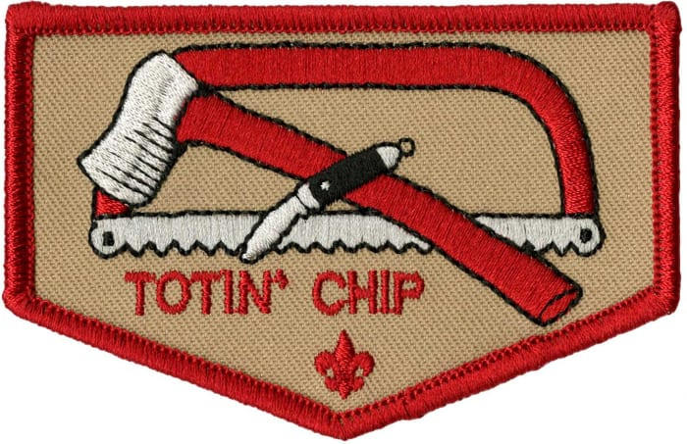
Requirement 2
Do the following:
  Earn the Totin' Chip recognition.
  Discuss with your merit badge counselor your understanding of the Safety Checklist for Carving.

Slide 10
Totin’ Chip Requirements
This certification grants a Scout the right to carry and use woods tools. The Scout must show their Scout leader, or someone designated by their leader, that the Scout understands their responsibility to do the following:
  Read and understand woods tools use and safety rules from the Scouts BSA handbooks.
  Demonstrate proper handling, care, and use of the pocketknife, ax, and saw.
  Use knife, ax, and saw as tools, not playthings.
  Respect all safety rules to protect others.
  Respect property. Cut living and dead trees only with permission and good reason.
  Subscribe to the Outdoor Code.
The Scout’s “Totin’ Rights” can be taken away if they fail in their responsibility.

Slide 11
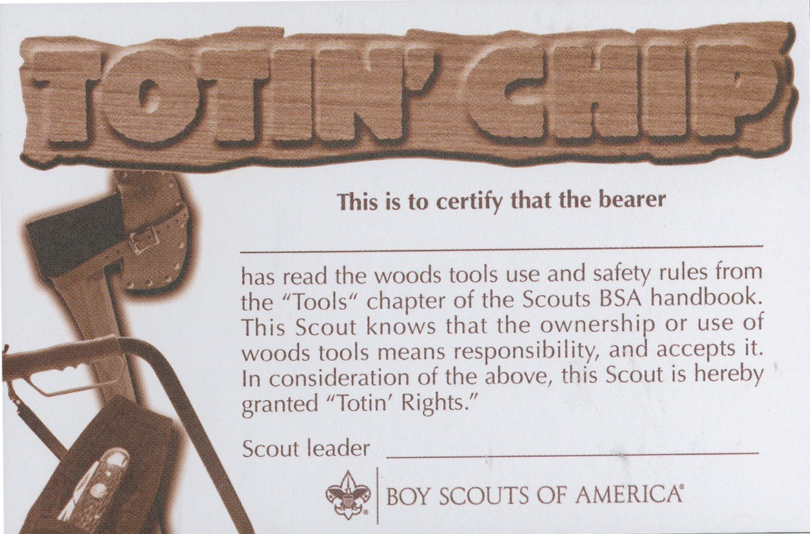
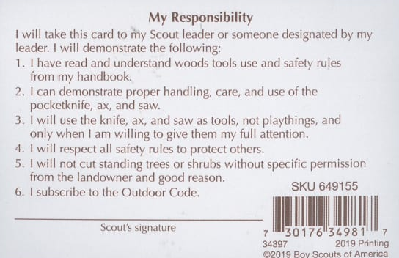
Totin’ Chip Requirements
Totin’ Chip Lesson Plan

Slide 12
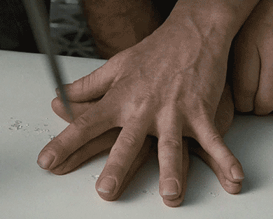
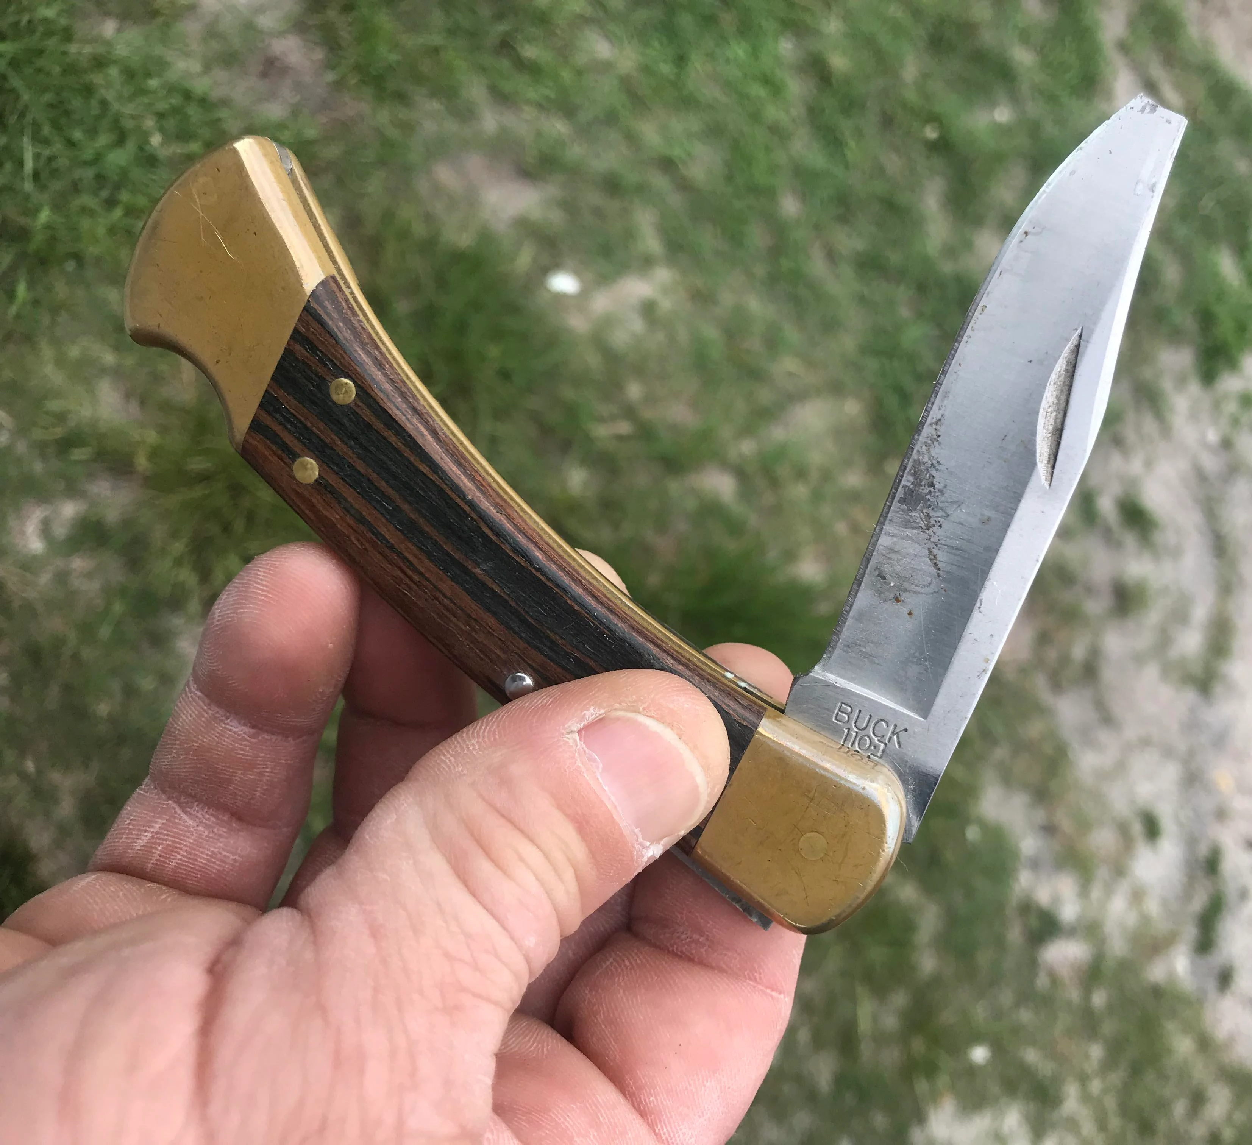
Safety Checklist for Carving
Personal Maturity and Judgment
  Knives and other carving tools are not toys and should never be thrown.
  At home, carve only with your parent’s approval.
  Carve only when you can focus on your work and are alert, and limit visiting while carving.
  Never bring a knife to school without permission.
  Never engage in horseplay around or with knives.
Caring for Your Tools
  Keep your tools and knives sharp and free from rust and dirt.
  If you are old enough to use power tools, make sure you understand how to use them properly.
  Wear protective gear such as safety glasses and, when appropriate, a dust mask.
  Store tools in a safe place and away from children.
  Never use a knife to pry something open.

Slide 13
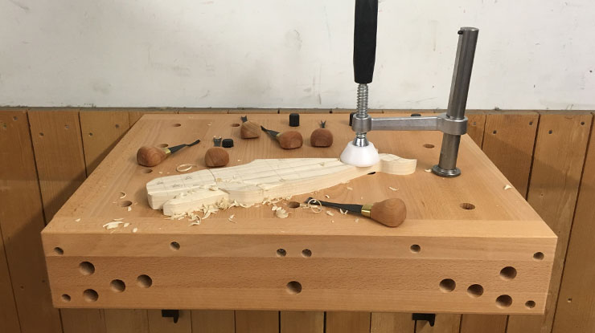
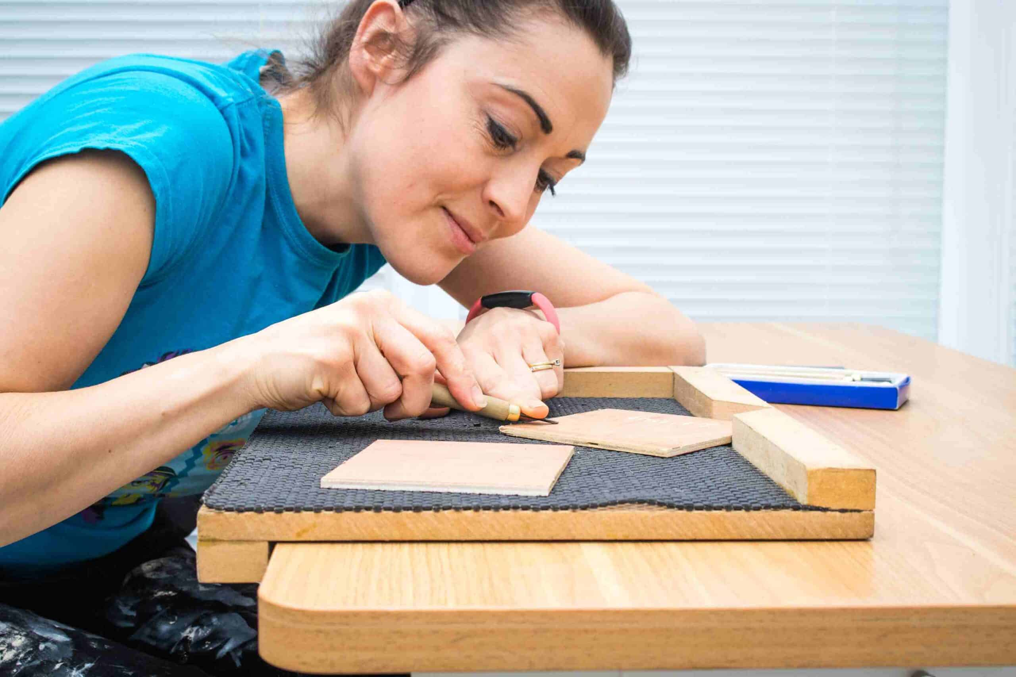
Safety Checklist for Carving
Controlling the Work Environment
  Use a clamp or bench stop for better control when carving small or oddly shaped objects; use a plastic mat or bench stop for extra control and safety.
  Use a clamp to hold down wood when using a coping saw.
  Use a safety table with a sturdy chair and adequate lighting.
  Cover the table to protect its surface; keep adequate space around you with no one else close enough to bump you.
  Keep your elbows on the table for more control so you will be less likely to get cut.

Slide 14
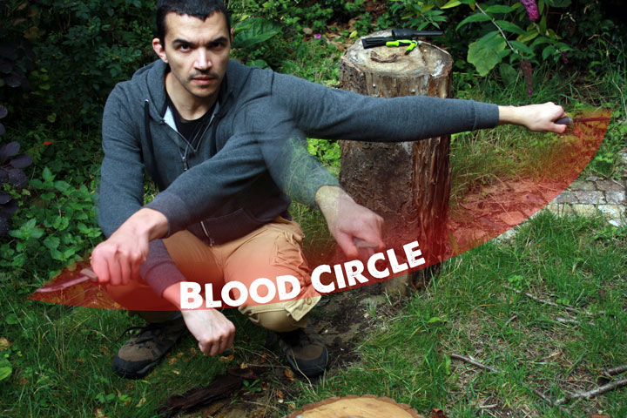
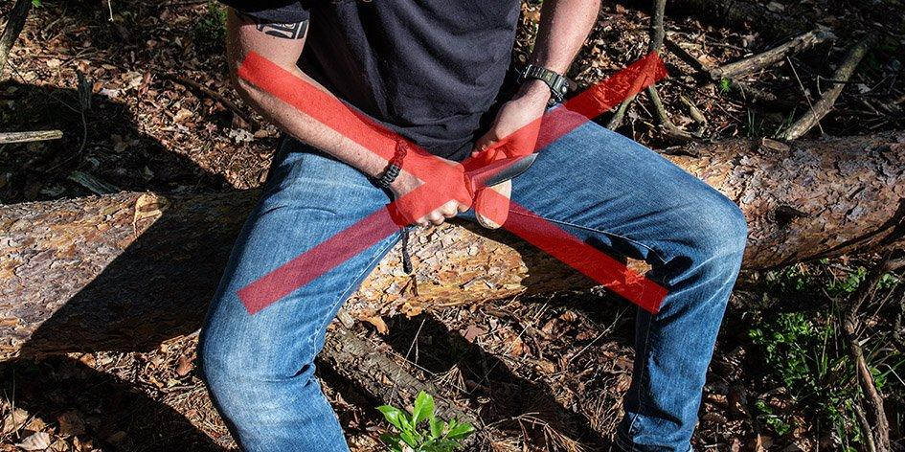
Safety Checklist for Carving
Handling Knives
  Never pass a knife across other people at the table.
  Never carve in your lap or near your face.
  Take small, well-placed carving strokes that give you more control over your work.
  Never “muscle” a project when carving.
  Always make sure your knife is sharp. Dull knives are dangerous knives.
  Never hammer the top of a knife to make a cut.
Making the Right Choices
  Choose the right wood for the project.
  Start with simple projects.
  When laying out projects, have plenty of space for cutting them out.

Slide 15
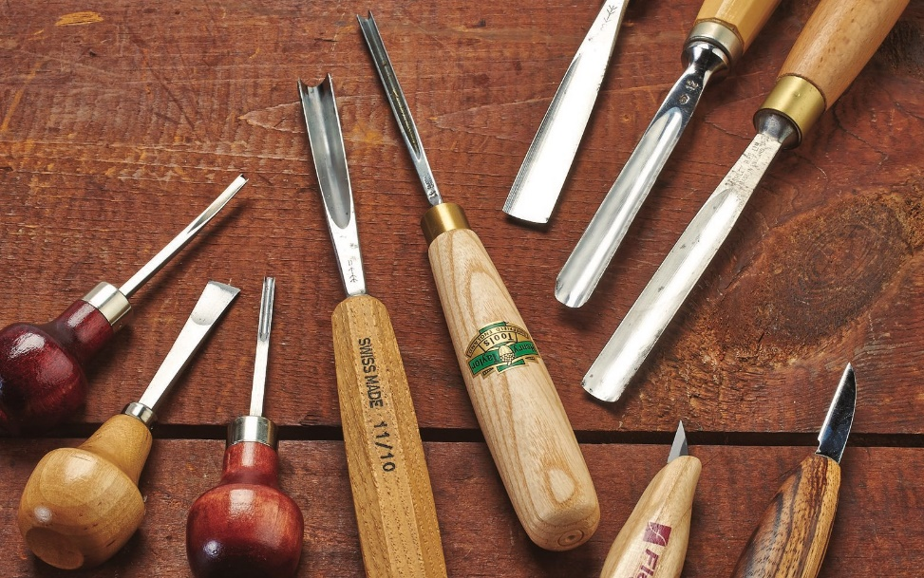
Requirement 3
Do the following:
  Explain to your counselor, orally or in writing, the care and use of five types of tools that you may use in a carving project.
  Tell your counselor how to care for and use several types of sharpening devices, then demonstrate that you know how to use these devices.

Slide 16
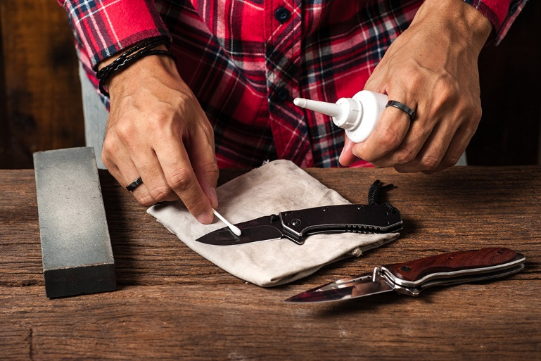
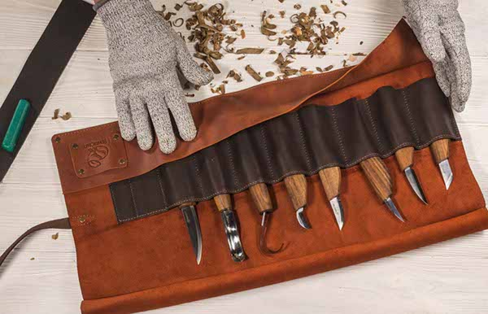
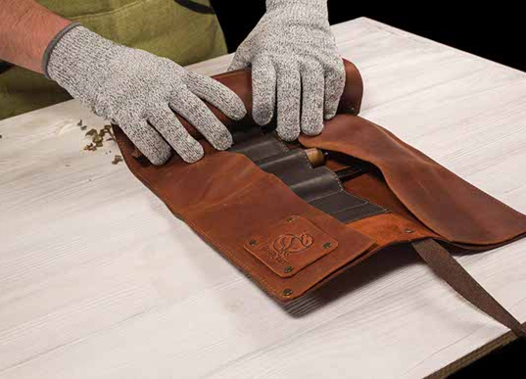
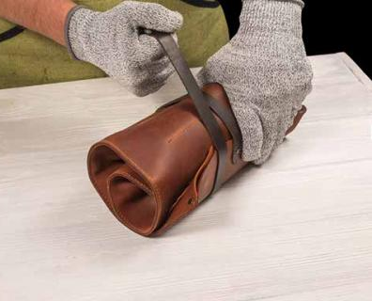
Care and Use of Tools
Check tools for dirt and rust on a regular basis.
Keep tools dry.
Wipe off fingerprint marks and moisture with a dry cloth.
Apply a couple drops of mineral oil to the blades and joints of a knife.
Keep chisels, gouges, and other tools wrapped in a soft cloth or leather so they do not damage each other while stored.

Slide 17
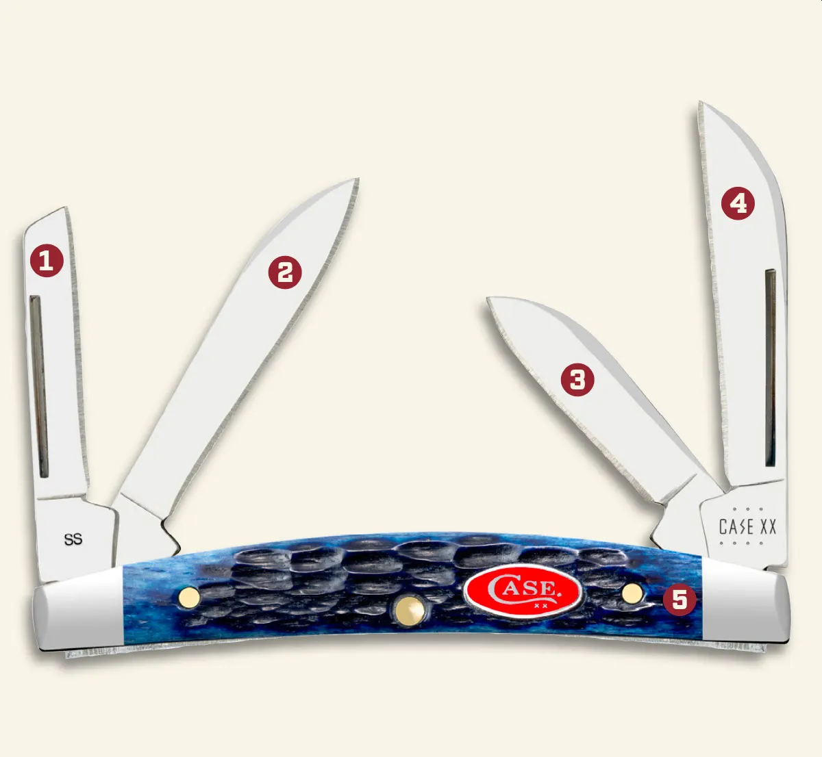
Wood Carving Tools
Whittler’s Knife
Coping Blade: This is used commonly in carpenter’s knives to scratch lines in wood or other materials. It is also used for carving and whittling.
Spear Blade: Features a symmetrical shape with a stronger blade tip for piercing.
Pen Blade: Great for light-duty work.
Sheepfoot Blade: Ideal for carving and carpentry
work.
Handle

Slide 18
Wood Carving Tools
Bench Knife:
  The bench knife has a thin blade that will be about 1 3/4 inches to 3 inches long, and tapers to a point at the tip of the blade.
  The entire straight faced edge of the blade is sharpened to provide you with an ability to cut lines into the wood and to whittle away long slivers of excess material.

Slide 19
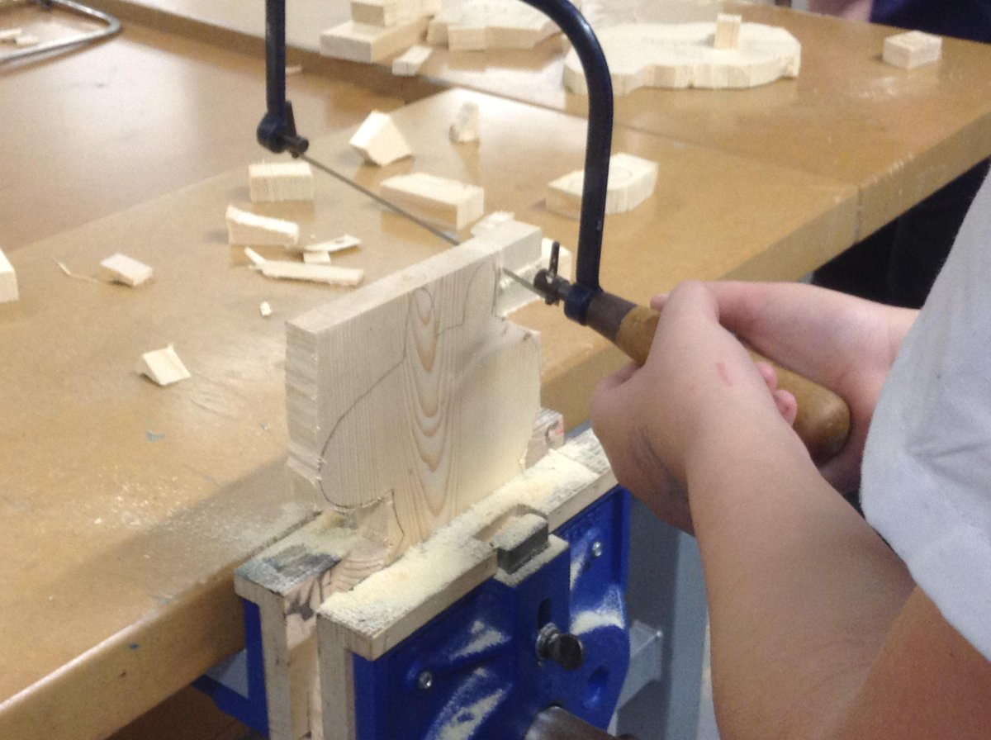
Wood Carving Tools
Coping Saw:
  A small saw that is used to cut off chunks of wood

Slide 20
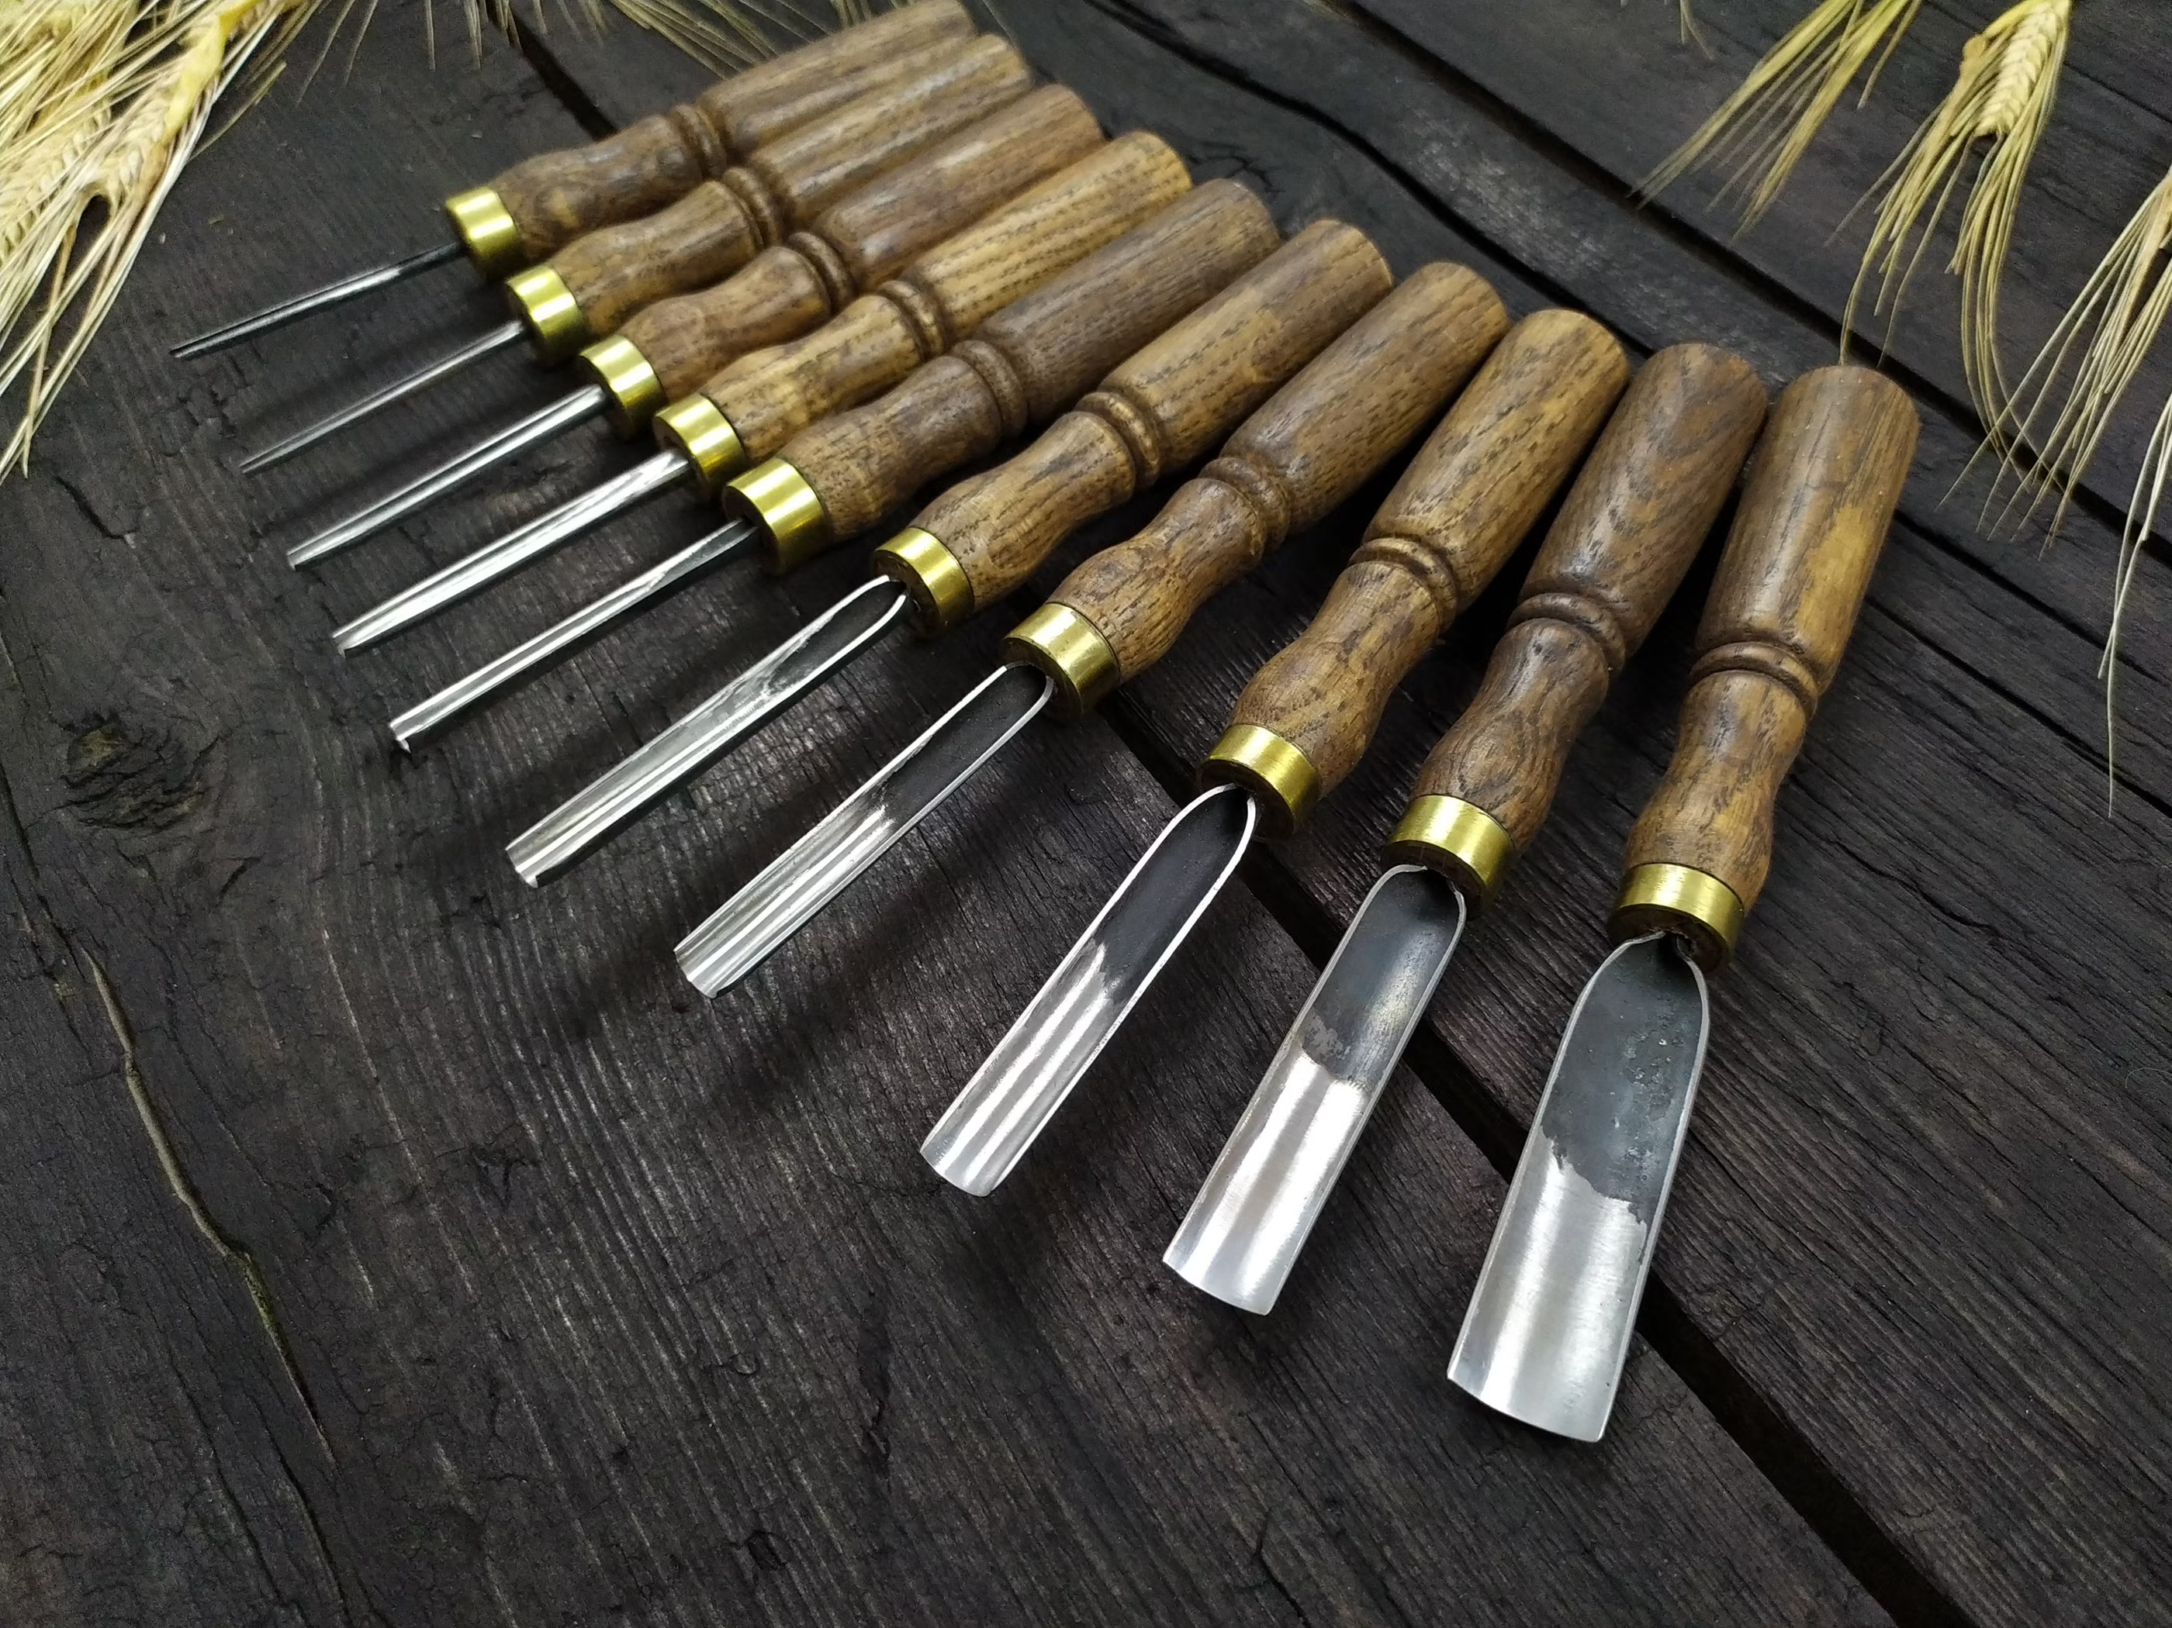
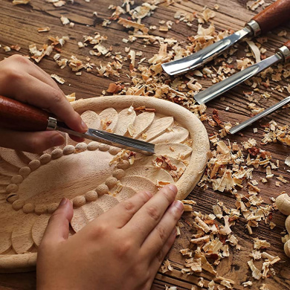
Wood Carving Tools
Round Gouges:
  The gouges end with a blunt cut.
  The full length of the blade is either rounded for c-curve gouges or tightly rounded for u-curved gouges.

Slide 21
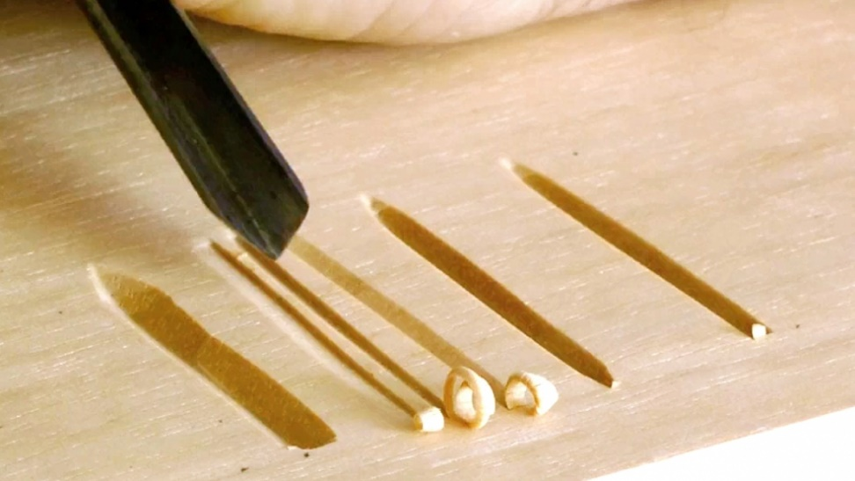
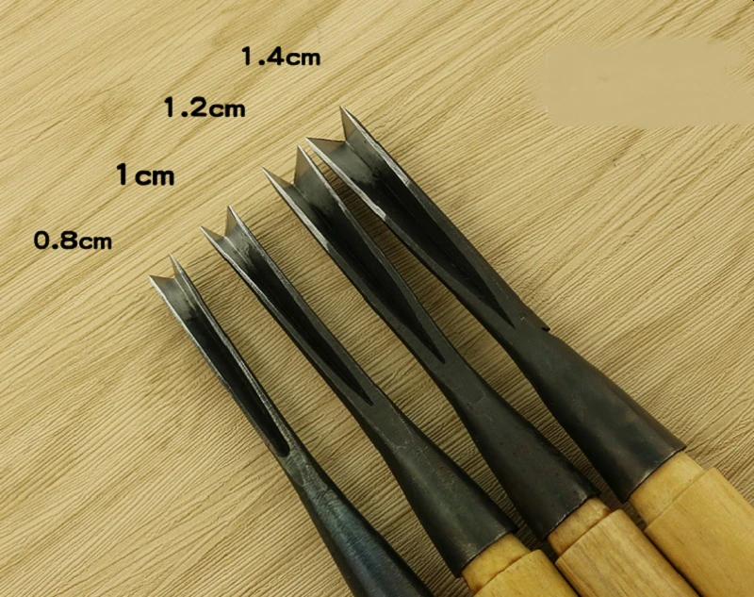
Wood Carving Tools
V-Gouge Chisel:
  This tool comes to a sharp “V” point at the tip creating a deeply scored line in the wood.
  “V” gouges are available in a variety of angles from very tight v’s to widely open v’s.

Slide 22
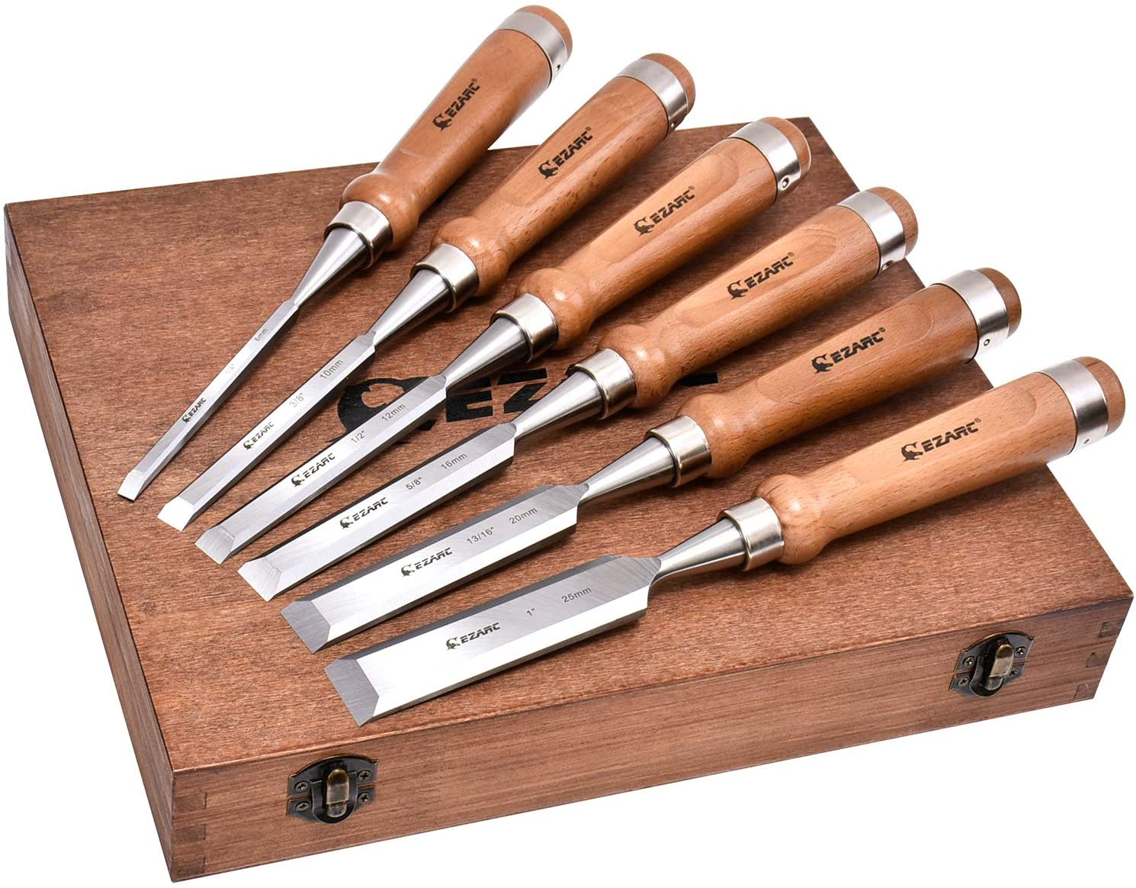
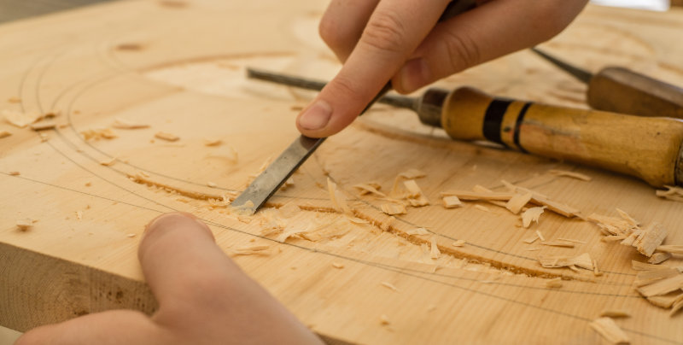
Wood Carving Tools
Straight Chisels:
  Chisels also have only the final edge of the tool sharpened, however the end will be cut in a flat end or angled end.
  These flat blades are used for the stop cut in relief carving, for removing large areas, and for crisping corners.

Slide 23
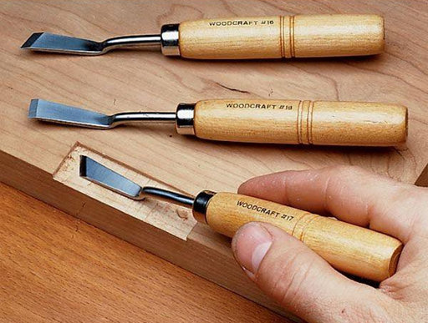
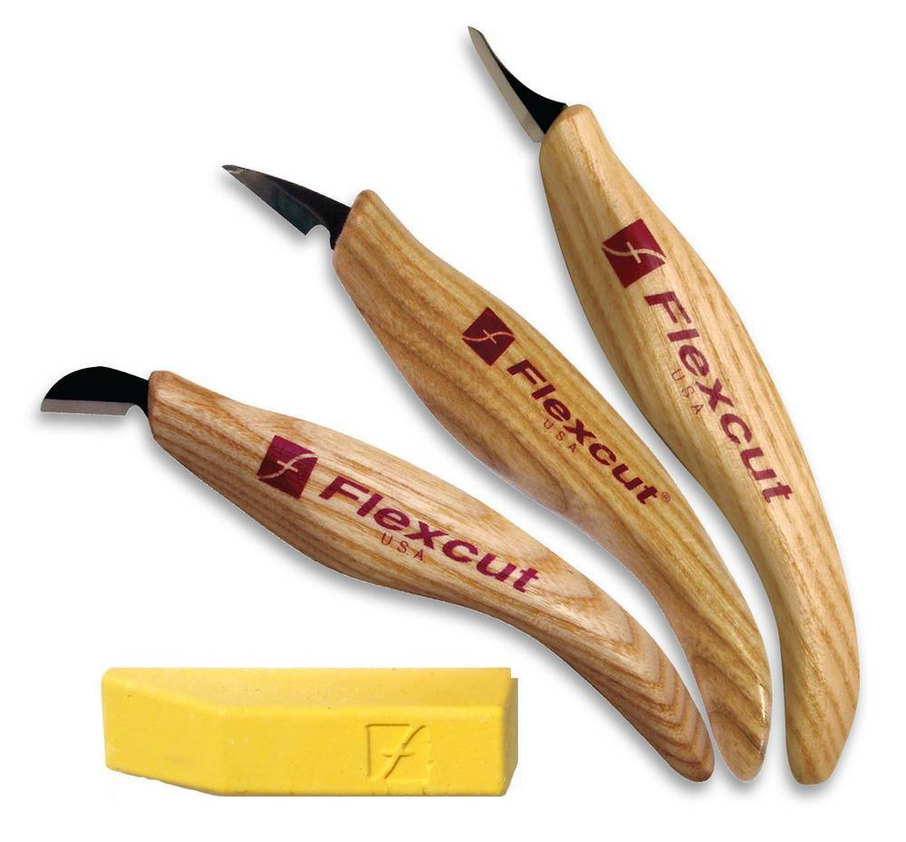
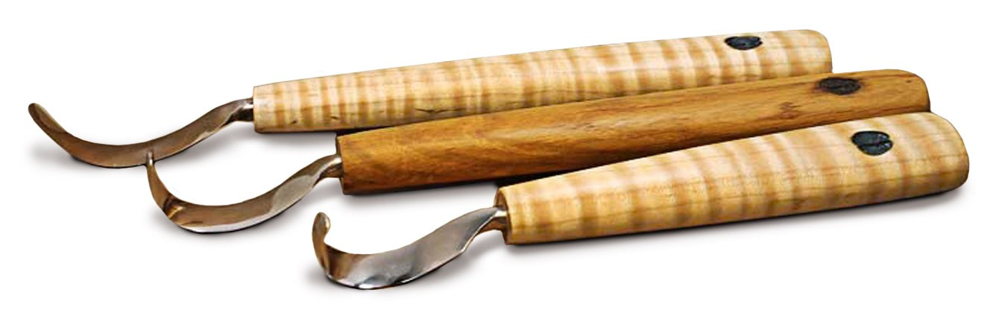
Wood Carving Tools
Specialty Knives:
  Dog leg chisel used to clean the background wood, under deep ledges, or undercuts.
  Detail knives for fine line work and for cutting into small, tight areas.
  Spoon hook knives for carving spoons and bowls.

Slide 24
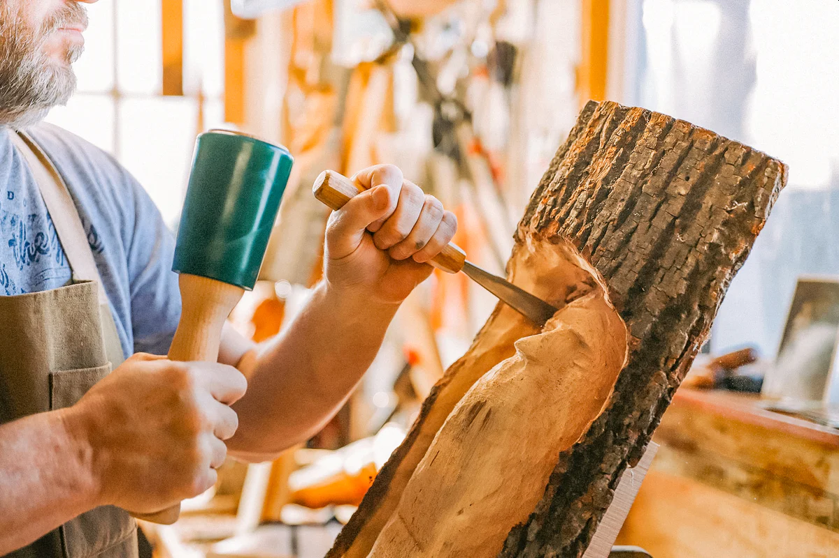
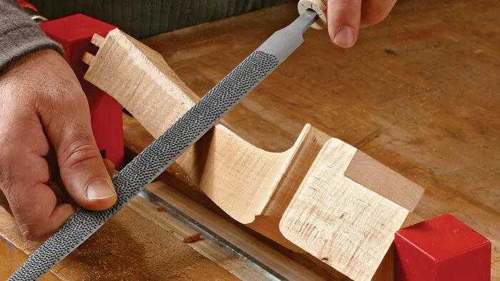
Wood Carving Tools
A carver also needs:
  A wooden mallet
  A flat wood file
  Rulers
  Pencils
  Clamps
  Rubber mats
  Sandpaper

Slide 25
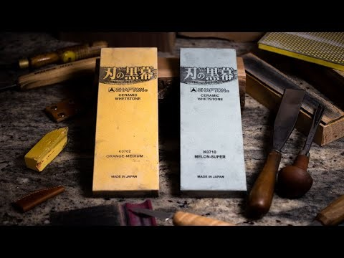
Care and Use of Sharpening Devices
This video walks you through how to sharpen wood carving tools. It covers chisels, v-tools, gouges, and knifes, using Japanese water stones, a diamond plate and a strop to get a razor sharp edge on the carving tools. It also discusses how to maintain that edge.

Slide 26
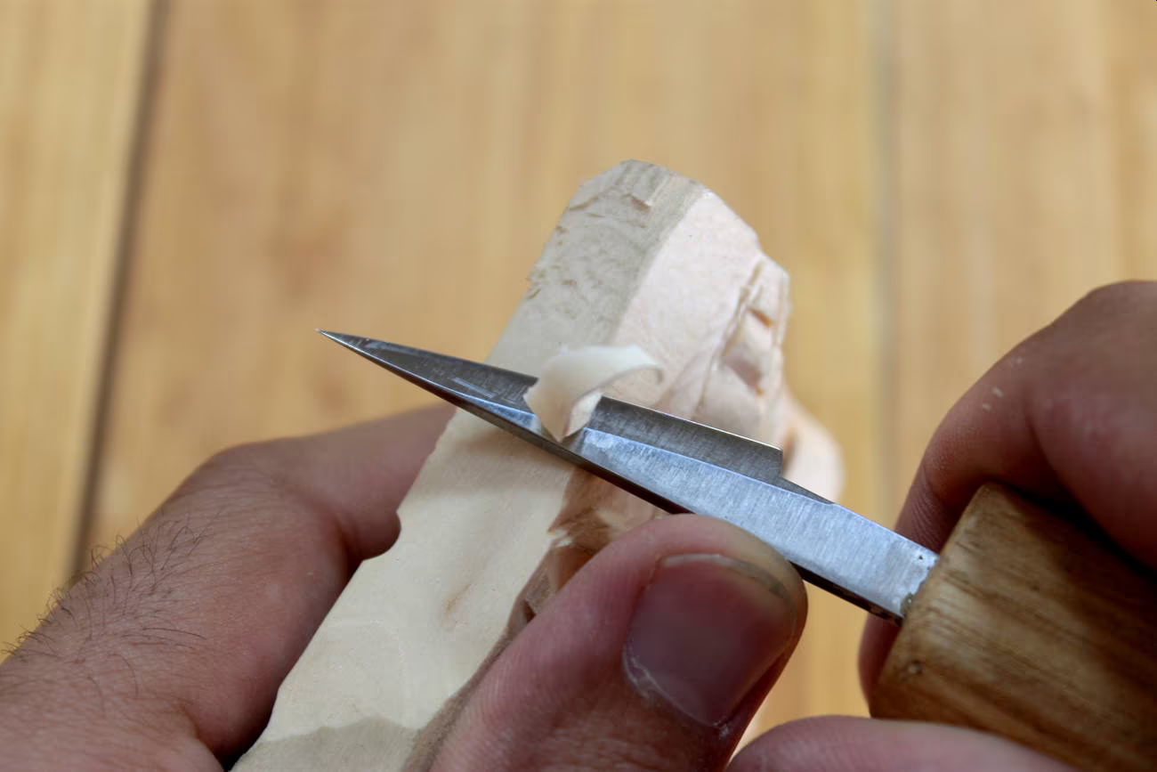
Requirement 4
Using a piece of scrap wood or a project on which you are working, show your merit badge counselor that you know how to do the following:
  Stop cut or score line
  Paring cut
  Push cut and levering cut
  "V" cut

Slide 27
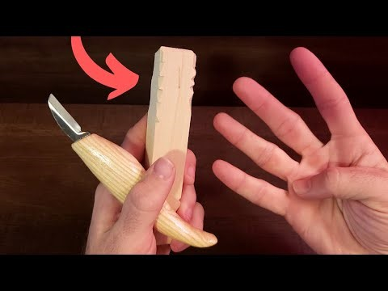
Basic Woodcarving Cuts
There are a few important techniques that every beginner should know--whether you're just whittling for fun or diving deep into the woodcarving hobby. This video will demonstrate the four basic cuts and some safety tips.

Slide 28
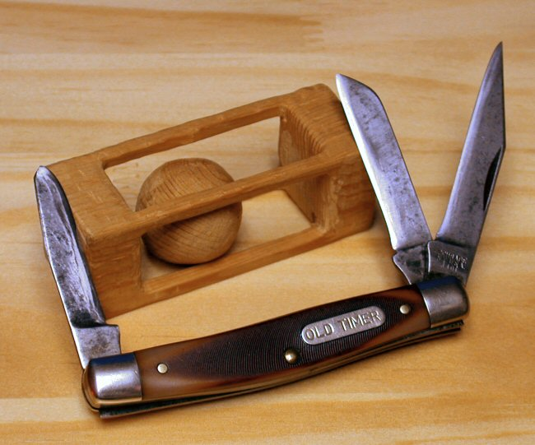
Requirement 5
Tell why different woods are used for different projects. Explain why you chose the type of wood you did for your projects in requirements 6 and 7.

Slide 29
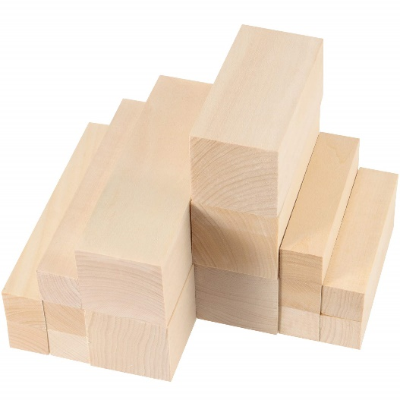
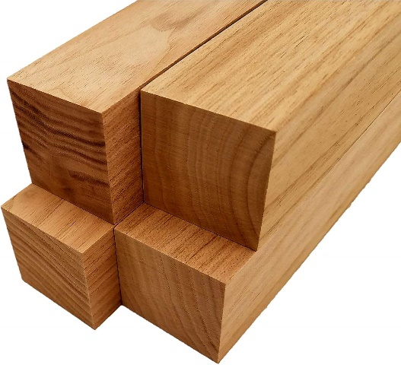
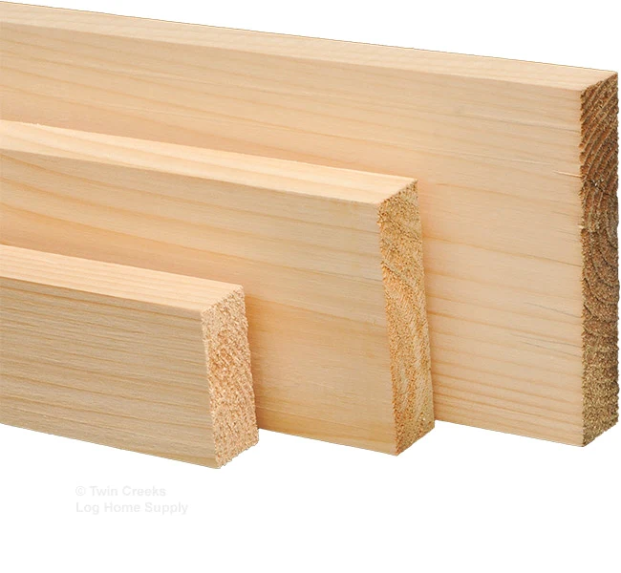
Wood Types
Soft Woods:
  Basswood
    Easy to carve, with a fine grain. Light and cream colored. Best for whittling.
  Butternut
    Easy to carve, with a coarse grain. Light brown colored with a distinct wood pattern.
  White Pine
    Easy to carve, with a medium grain. Soft and cream colored.

Slide 30
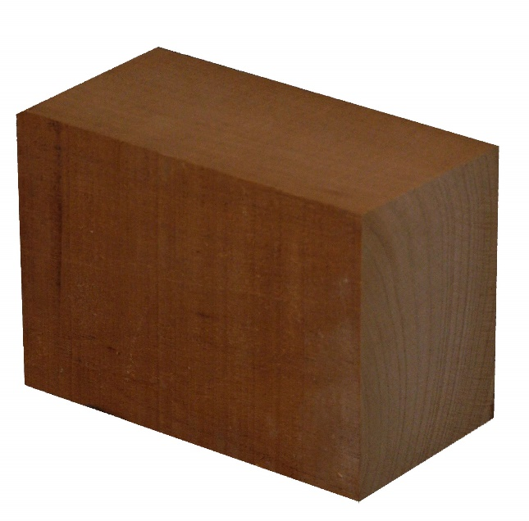
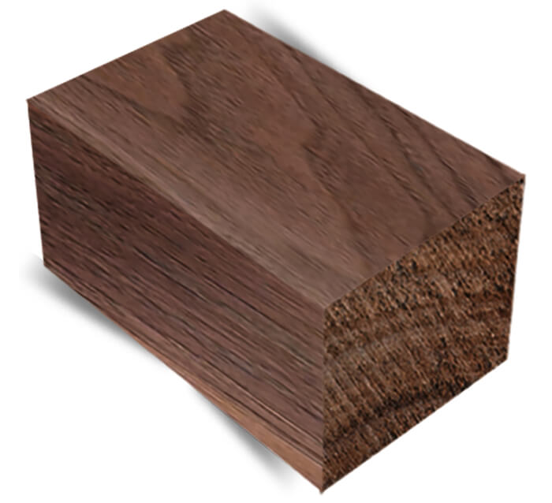
Wood Types
Intermediate Woods:
  Mahogany
    Intermediate difficulty to carve, with a medium grain. Distinct reddish color.
  Black Walnut
    Intermediate difficulty to carve, with a medium grain. Very dark brown.

Slide 31
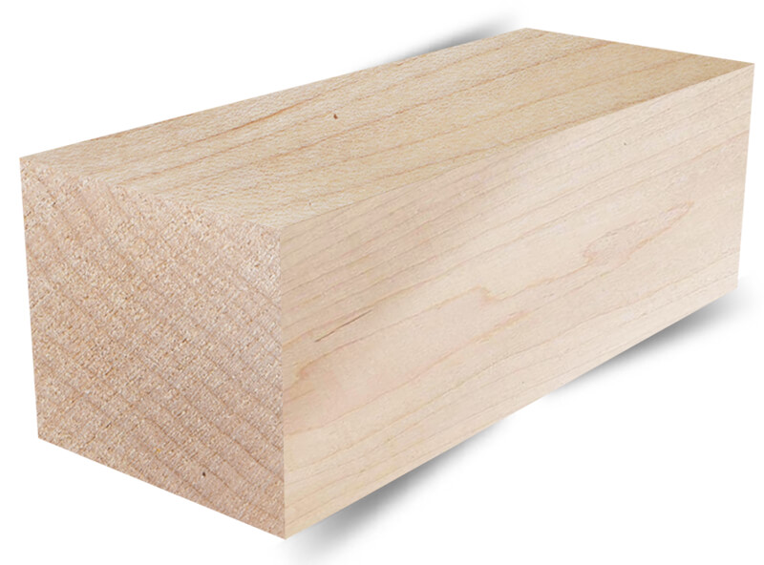
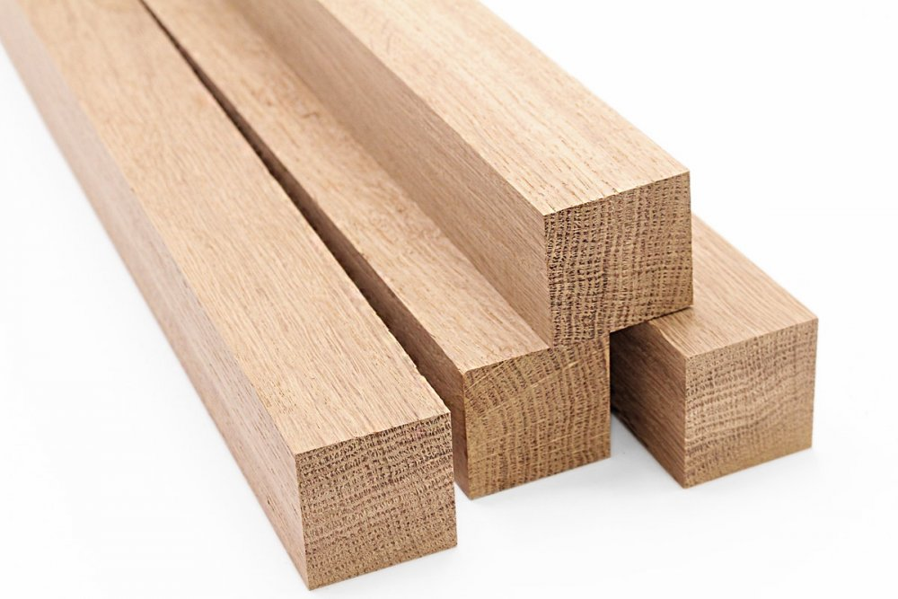
Wood Types
Hard Woods:
  Sugar Maple
    Very hard to carve, with a fine grain. Very light cream color.
  White Oak
    Very hard to carve, with a medium to coarse grain. Very light, yellowish color.

Slide 32
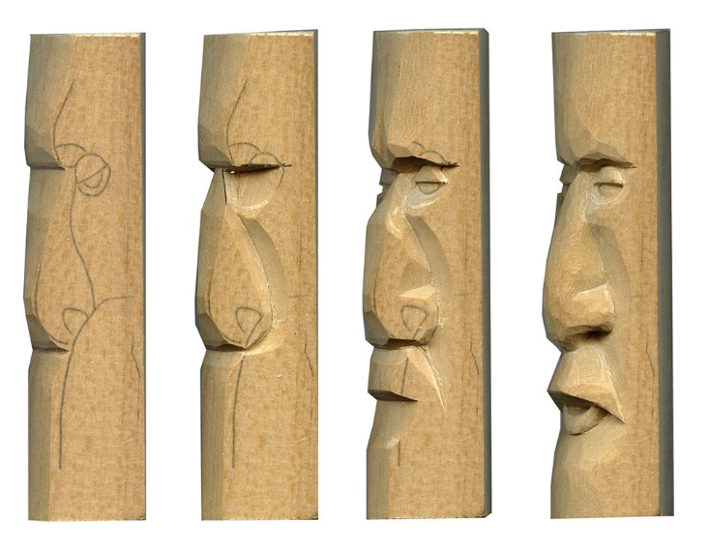
Requirement 6
Plan your own or select a project from the Wood Carving merit badge pamphlet and complete a simple carving in the round.

Slide 33
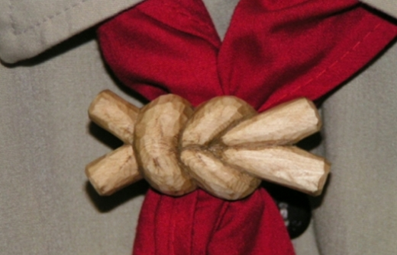
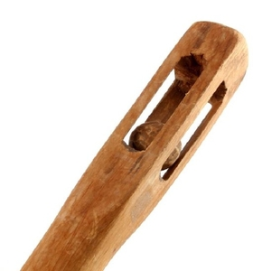
Carving in the Round
Making a three-dimension carving is known as carving in the round.
These carvings include neckerchief slides, small statues, and walking sticks.
A slide does not have to be carved on the back side.

Slide 34
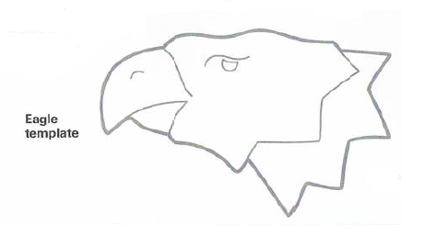
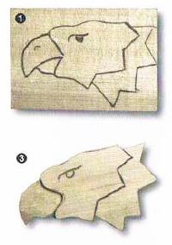
Eagle Neckerchief Slide
Step 1 - Transfer the eagle design onto a block of wood 3 3/8” with the grain and 2 1/4“ across the grain. Use basswood if possible.
Step 2 – Cut or carve out the outside profile of the eagle.
Step 3 – Score the line separating the beak and the forehead of the eagle. Then carve back to your score line, keeping the beak flat at this time.
Step 4 - Score the line separating the upper and lower parts of the beak. Carve on the lower part of the beak so it is recessed from the top. Now you can round off and shape the top of the beak.

Slide 35
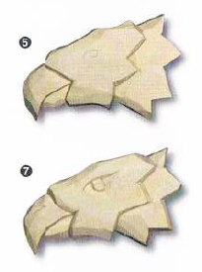
Eagle Neckerchief Slide
Step 5 – Score the back part of the eagle head. Carve back and use a stop cut to the line that you have scored. Slightly round off the top and bottom of this back portion of the eagle head, making the top and bottom look like they go around the neck of the eagle.
Step 6 – Slightly carve the top and bottom and edges on the middle portion of the eagle. To give it a nicer look, carve a little off near where the middle section meets the back part and the beak.
Step 7 - Now, carve the details, including the eye and air vent hole.

Slide 36
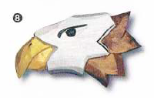
Eagle Neckerchief Slide
Step 8 – Glue on slide back. Let the glue dry and paint the slide. The eagle in the slide shown has a yellow beak, white middle, and grown end. The eye and vent hole on the beak are black.

Slide 37
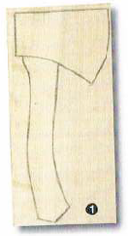

Ax Neckerchief Slide
Step 1 - Draw the ax onto a block of wood 5” with the grain and 2 3/8” across the grain. Use basswood if possible.
Step 2 – Cut or carve the outside shape of the ax. Score the line between the handle and the head of the ax. Draw a line on the side of the handle and carve the entire handle down to the line without rounding the edge at this time.

Slide 38

Ax Neckerchief Slide
Step 3 - After carving the handle flat along the entire front view, round off the two front edges of the ax handle.
  If the knife blade starts taking off more and more wood, stop and change the direction your are carving. You’re probably hitting a grain change in the wood, or you’re going into the wood at too much of an angle. Flatten the knife blade angle and take small deliberate cuts.
  You may be tempted to put a sharp edge on the ax, but it only has to be tapered. You can make it look like a sharp ax when you paint it.

Slide 39

Ax Neckerchief Slide
Step 4 - Glue on the slide back. Let the glue dry, and then paint. The handle has been left natural. Use medium gray (not silver) for most of the head. Add white to medium gray and paint in the sharpened area.

Slide 40

Eagle Walking Stick
Step 1 – Looking down on the top end of the stick, turn the stick so the square becomes a diamond shape. Draw a straight line from the top of the diamond down to the bottom. Then draw to other parallel lines, both 3/16” from each side of the center line.
Step 2 – Keeping these lines vertical, make a small dot 9” down on one side edge of the stick. Repeat on the opposite edge.

Slide 41

Eagle Walking Stick
Step 3 – Draw a line connecting the left dot with the top of the left line you drew on the square. Then connect the dot with the bottom of the line. Do the same on the right.
Step 4 – Taper the stick by carefully removing these outside corner wedges of wood from the dots forward. This will give a fairly flat surface on both sides to help you sketch the beak and head profile.

Slide 42

Eagle Walking Stick
Step 5 – Draw the eagle profile. Either sketch it on paper and transfer it to the flat surface of the wood, or draw it directly on the wood. To get the two eyes the same, draw and cut one eye on an index card. Us the card as a template and trace it on both sides of the head.
Step 6 – Following the lines of the pattern, carve away wood from in front of the forehead and from the top and bottom of the beak.
Step 7 – At the back of the eagle’s head, cut away the top and bottom edges of the stick. This will form the profile of the top feathers and will give you a complete silhouette of the eagle’s head.

Slide 43

Eagle Walking Stick
Step 8 – Carve away wood from the sides of the beak, making it somewhat lower than the cheeks and slightly tapered toward the end. Remove a little extra wood from the sides of the bottom portion of the beak to make it appear the top part is coming down over it. Now, soften the beak edges, rounding them out.
Step 9 – Leaving the top and bottom edges of the head area alone, shape and round the sides to form the front part of the face, tapering it down to the beak.

Slide 44

Eagle Walking Stick
Step 10 – Score all the lines for feathers on one side of the eagle. To score, hold the knife in a pencil grip, exerting force to make a cut 1/8” in depth. When a cut is made back to this line. It will act as a stop line and the piece of wood will fall out. Starting with the layer farthest away from the beak, cut back to the score line to form the feathers. Repeat on the other side.

Slide 45

Eagle Walking Stick
Step 11 – Not that the eagle head is completely carved, round out the staff. Do not try to remove all the knife marks. The carvings will not only make the stick look more natural, they will also improve your grip. Round the edges of the bottom of the walking stick to help prevent cracking and chipping.
Step 12 – Using oil or enamel, paint the eagle head. Paint the beak yellow, the eyes black, the back feathers brown, and the rest white. The staff itself should not be painted. After the paint is thoroughly dry, a coat of polyurethane, shellac, or varnish will help keep stains and dirt from discoloring the stick.

Slide 46


Requirement 7
Complete a simple low-relief OR a chip carving project.

Slide 47


Low-Relief Carving
In wood carving relief carving is a type in which figures or patterns are carved in a flat panel of wood.
Low-relief (or bas-relief) carvings are shallow, with minimal shadowing. The rule of thumb for low-relief carvings is that the depth is less than ½ inch.

Slide 48


Low-Relief Carving
Step 1: Find or create a pattern.
  Whether you draw your own patter or download free relief wood carving patterns from the internet, you need to copy it to a transfer paper, and then lay it out on the wood panel.
Step 2: Prepare the wood for carving.
  Before you start carving, you should lay out the wood panel on a desk or bench, and fix it so it cannot move. You can use bar clamps on each side.

Slide 49


Low-Relief Carving
Step 3: Bring the pattern onto the wood panel.
  It is essential for the wood to be still before you apply the carbon paper onto your surface for carving.
Step 4: Remove excess material from the edges of the pattern.
  Use your mallet and chisel to outline your project and prepare it for carving.

Slide 50


Low-Relief Carving
Step 5: Outline the depth of the project.
  Your wood carving relief will have different heights, so make sure to roughly define how deep does a carving go.
Step 6: Detail carving.
  Here comes the actual thorough carving process that is very similar to chip carving. So, apart from using gouges and chisels, an ordinary chip carving guide can also explain the detail carving of a relief.

Slide 51


Low-Relief Carving
Step 7: Even the background.
  Once you are done with every detail of your project, clean up the board behind it to a level that you envisaged it has.
Step 8: Sand the project details, outline, and background.
  Smoothen the curves of your carving with a detail sander or an edge of the sandpaper wrapped around a tight cylinder such as a pen.

Slide 52

Low-Relief Carving
Step 9: Finish up the project.
  After sanding, you should clean the whole wood surface with a wet cloth and check for any excess wood you have forgotten to remove. From here, you can use oil as a finish to protect your carving, or apply a wood stain of your choice.

Slide 53

Chip Carving
Chip carving is a style of carving in which knives or chisels are used to remove small chips of wood from a flat surface in a single piece, usually in simple geometric designs.

Slide 54

Chip Carving Project
Materials Needed:
  4” x 4” piece of wood, about 1/2“ to 3/4“ thick.
  Sandpaper
  Ruler and pencil
  Thumb guard
  Chip carving knife
Your finished project can be used as a mounting board for a photo or a Scout Patch.

Slide 55


Chip Carving Project
Step 1 – Sand the wood smooth before drawing your design.
Step 2 – Use a ruler and pencil to draw two rows of quarter-inch squares on each side of the board.
Step 3 – Draw four triangles on each side of the board using two squares for each triangle.

Slide 56


Chip Carving Project
Step 4 – Number three sides of the board and one of the rows of triangles. Position your chip carving board so that side 1 is closest to you.
Step 5 – Begin carving on side 1 of the triangle by positioning the knife at a shallow angle and inserting just the tip to help keep the cut from going too deep. Slowly draw the knife toward your body using the upper arm, not the wrist. The thumb moves with the knife as you cut, and the inside joint of the thumb and the back of the knife blade are always held together.

Slide 57


Chip Carving Project
Step 6 – Turn the board so that side 2 is closest to you. Position the knife at the top of the triangle, with the sharp edge away from your body. Place your thumb at the back of the knife blade, and keep your elbow close to your body. Make a shallow cut by carefully pushing the knife along side 2.
Step 7 – Turn your board so that side 3 is closest to you, and carve side 3 using the same hand position you used for the first cut. The triangle chip should pop out as you finish the third cut.

Slide 58


Chip Carving Project
Step 8 – Clean up any extra wood on the bottom of the triangle by going over the cuts one more time using the same angles.
Step 9 – Finish the design by repeating the steps for each triangle around the block of wood. Sand the block of wood to remove any remaining lines and numbers.

